Slide 1
Jboss Fuse
Red Hat JBoss Fuse is an open, standards-based integration platform. It reduces the complexity of integrating disparate applications by leveraging the principles of Service Oriented Architecture (SOA) and standardized packaging frameworks.

Slide 2
Jboss Fuse
Red Hat JBoss Fuse is lightweight and can run on most platforms.
Red Hat JBoss Fuse uses the OSGi framework to simplify componentization of applications.
Red Hat JBoss Fuse provides a mechanism, Fuse Application Bundle (FAB), that automates creating and maintaining OSGi bundles.
FABs free application developers from the complexities associated with creating and maintaining OSGi bundles, enabling them to focus on building their applications. This is especially useful when you are developing large, complex enterprise applications. See FABs in a nutshell.
Red Hat JBoss Fuse supports the Java Business Integration (JBI) specification (JSR 208).

Slide 3
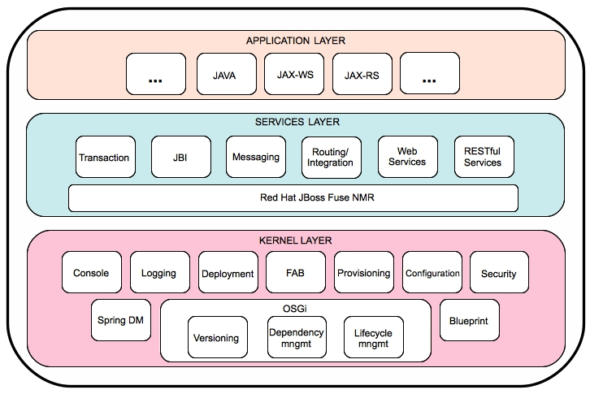
Jboss Fuse Architechture

Slide 4
Queue- and topic-based messaging
Request/reply messaging
Persistent and nonpersistent messages
JMS transactions
XA transactions

Slide 5
Enterprise integration patterns
Modular and pluggable architecture
Convention Over Configuration
Automatic type converters

